Slide 1


3 December, 2022
Sponsored and Supported by:

Slide 2


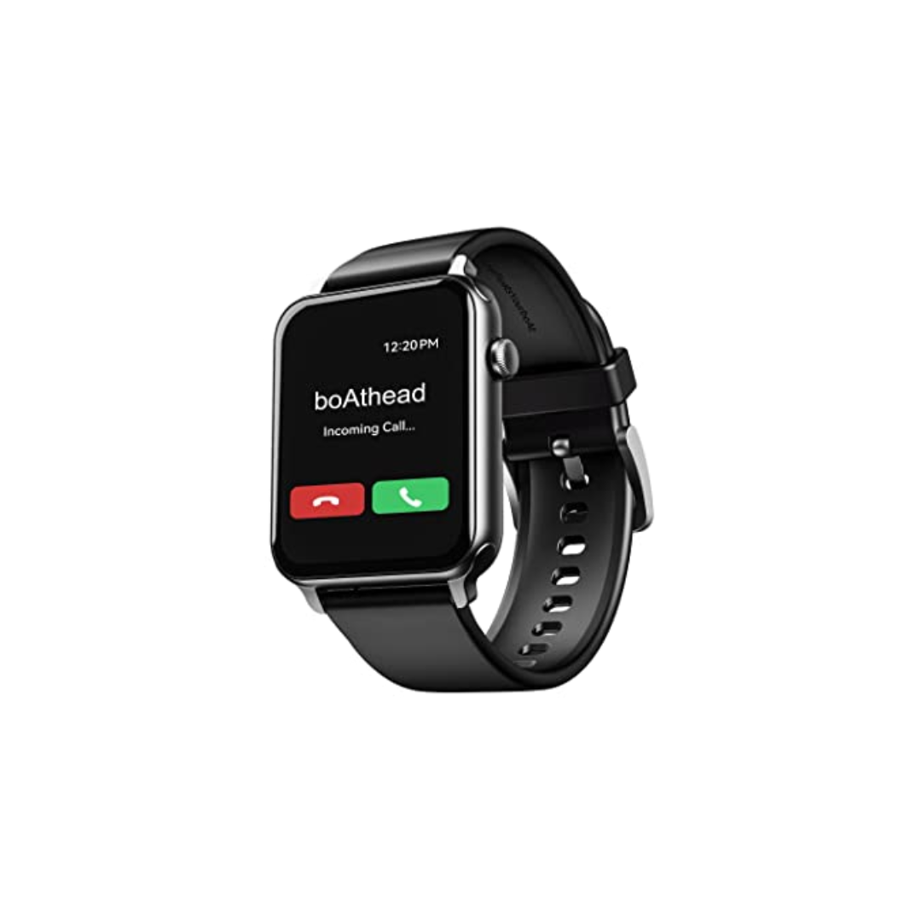

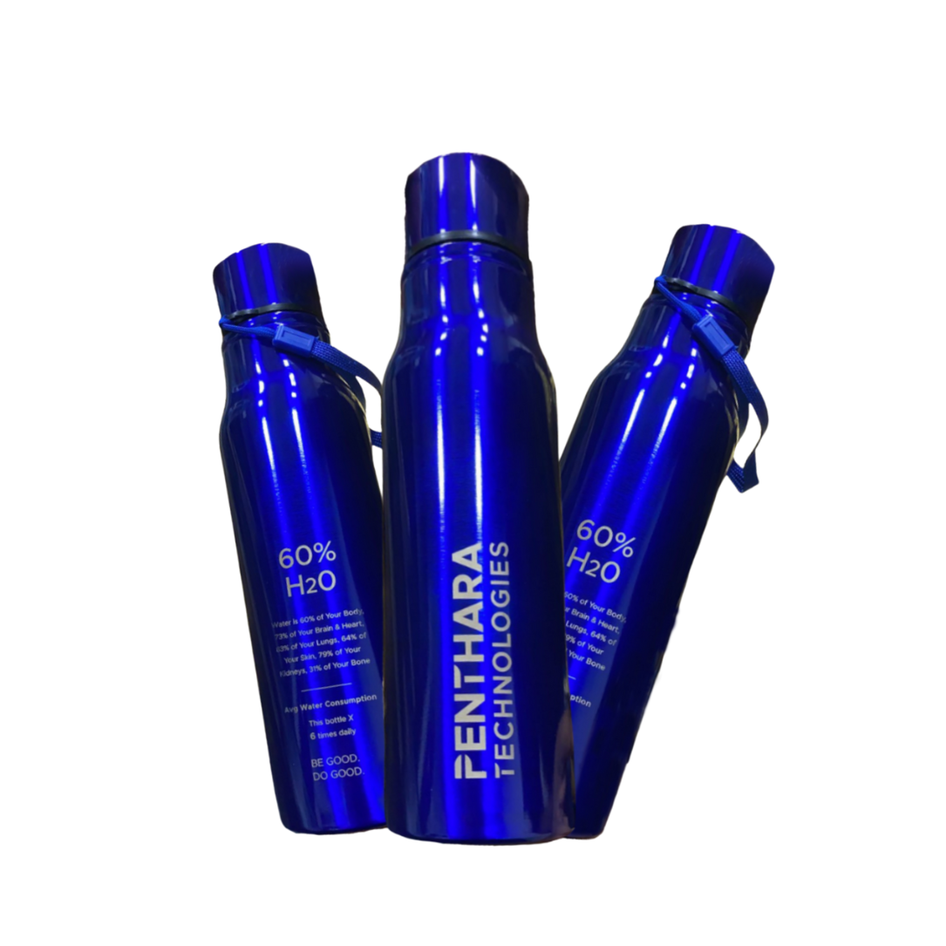

A One Day In Person Event
Win exiting prizes!
Lenovo M10 FHD Plus (2nd Gen)
JBL Tune 125TWS
boAt Blaze Smart Watch
Hands on sessions by experts and community leaders
Deep-dive into Microsoft 365 Services
Focus on:
Microsoft Teams
Power Platform
SharePoint
Cool Water Bottle
Developer Road Ahead

Slide 3

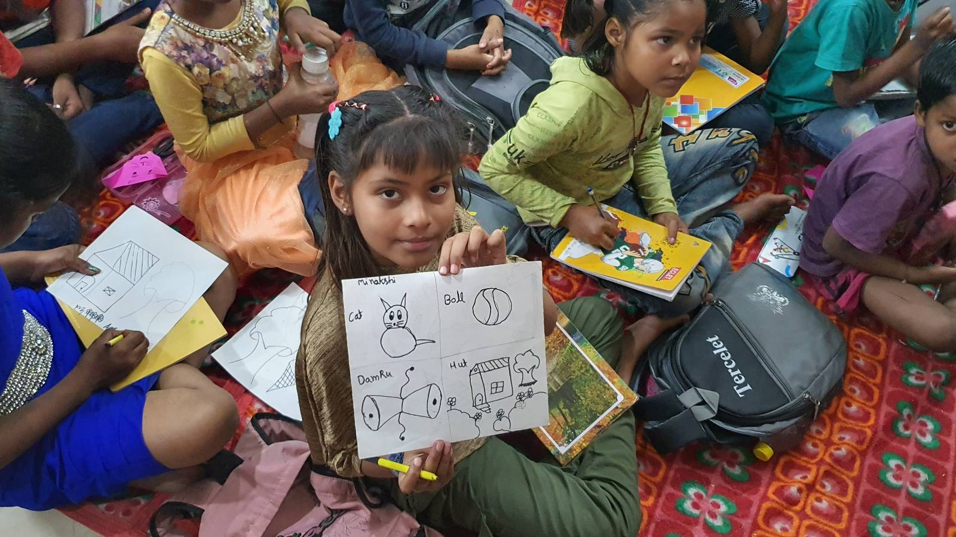
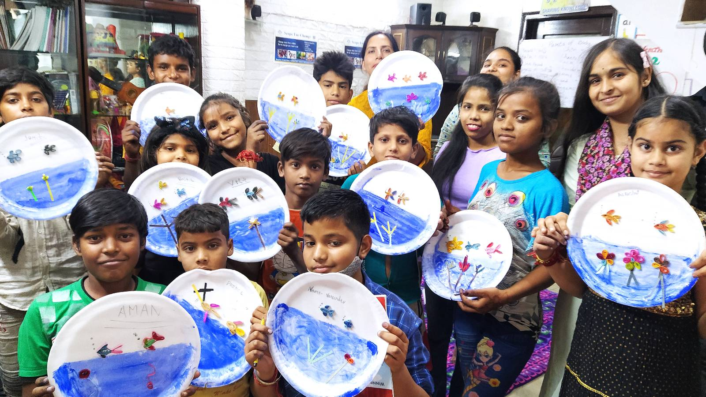

SUPPORT A CAUSE
“Giving is Receiving”
Support ‘Scope for Change’ to create more impact and touch the lives of more underprivileged students.

Slide 4
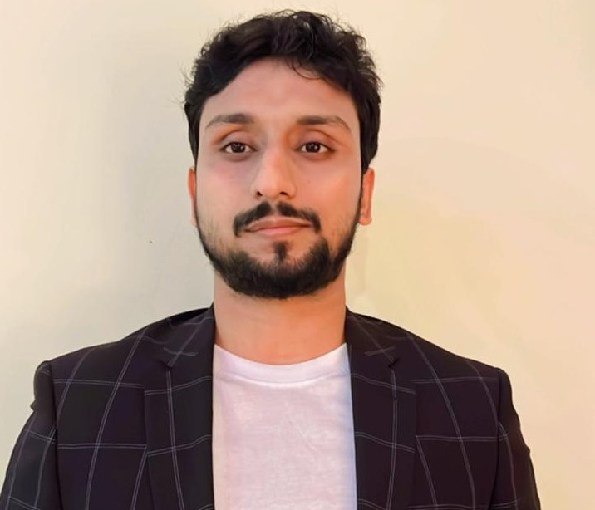

SPEAKERS PANEL
Session 3
Advance Hunting with Defender Portal
10:00 AM – 10:45 AM IST
Samik Roy
MCT, Lead Cloud Developer
https://github.com/samikroy
https://www.linkedin.com/in/roysamik/

Slide 5
Agenda
Why Defender
How to use the portal for hunting
Demo
Where to go for more
QnA

Slide 6
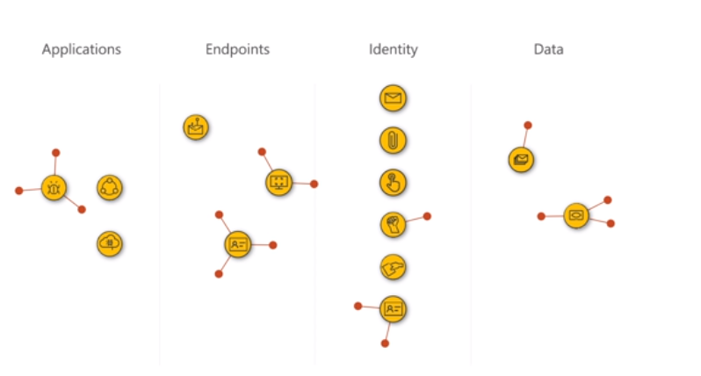
Why Defender
Attachment Opened
URL Clicked
Email Received
Lateral Exploitation
Exploitation
Microsoft Threat Protection

Slide 7
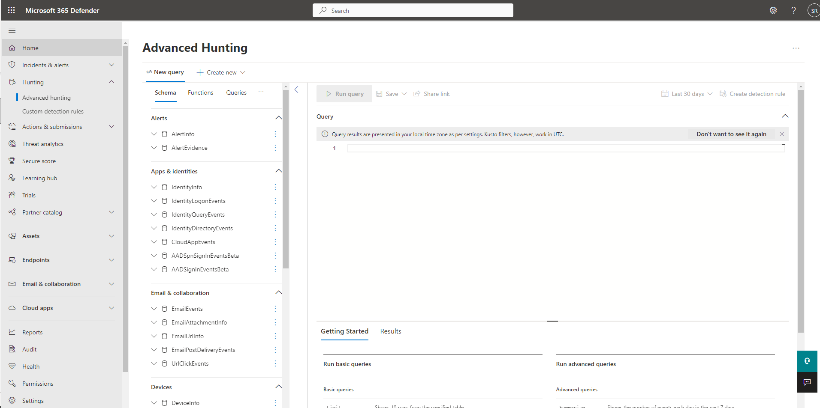
The Portal
Advance Hunting

Slide 8
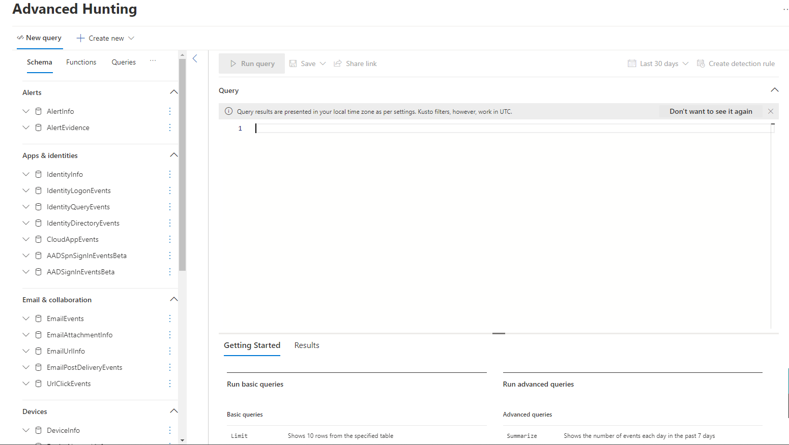
The Portal
Query Console
Left Navigation

Slide 9
Why Defender

Slide 10
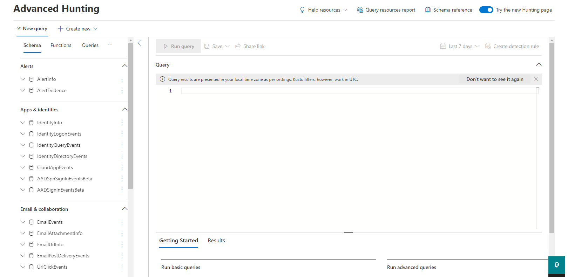
The Page

Slide 11
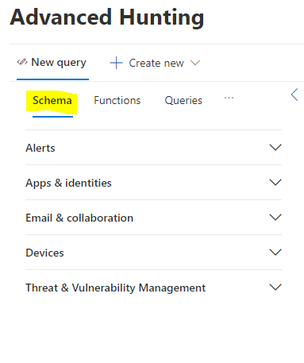
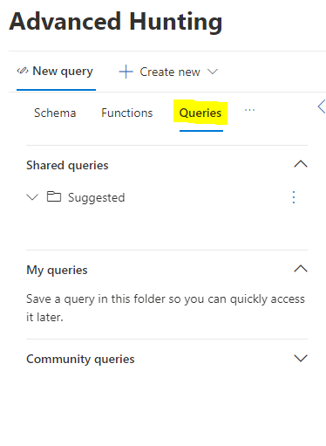
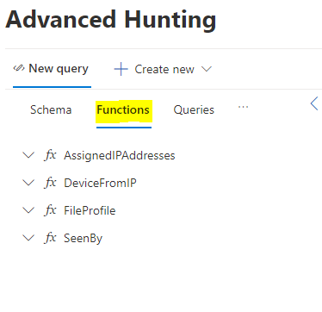
The Left Nav

Slide 12
Demo

Slide 13
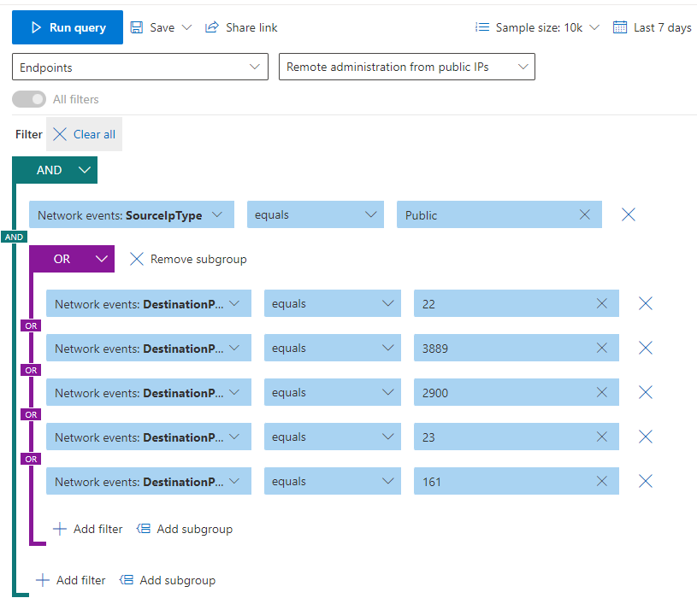
Query Builder

Slide 14
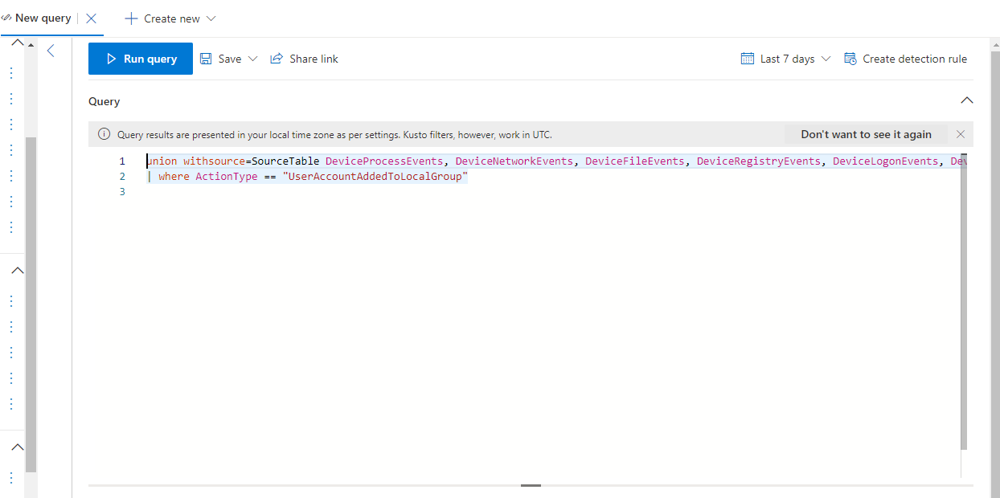
Query Editor

Slide 15
Questions

Slide 16
Thank You

Slide 17
Where To Go for More
GitHub - https://github.com/microsoft/Microsoft-365-Defender-Hunting-Queries
Webinars - https://techcommunity.microsoft.com/t5/security-compliance-and-identity/recordings-security-community-webinars/ba-p/2865990
Licenses - https://learn.microsoft.com/en-us/microsoft-365/security/defender/prerequisites?view=o365-worldwide

Slide 18







A Big Thank You to all the Sponsors!
Diamond:
Learning Partner:
Platinum:
Gold:

Slide 19
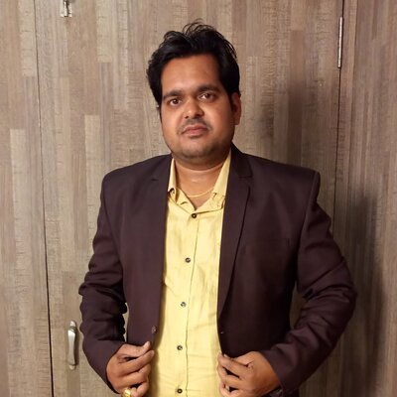
SPEAKERS PANEL
Next Session
How to configure data loss prevention (DLP) policies in Power Platform
11:00 AM – 11:45 AM
Aakash Maurya
Sr SharePoint Developer & Team Lead

